Slide 1
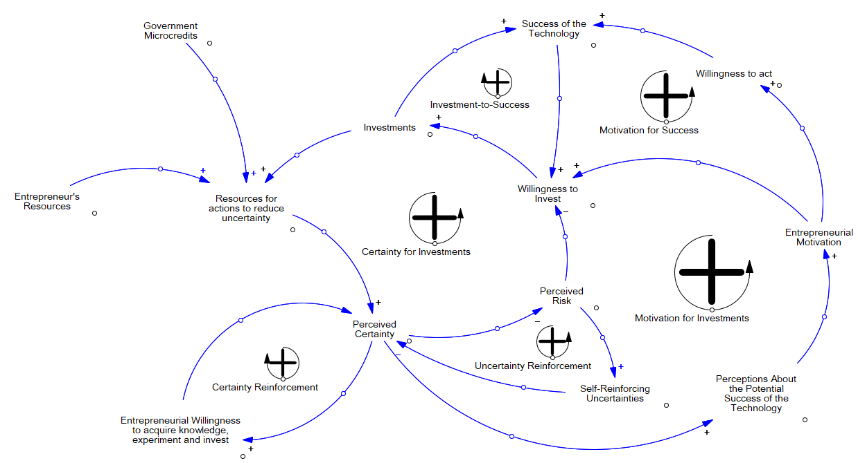
Government Credits for Innovation
Success of the Technology
Entrepreneur’s Resources

